Slide 1
QUAntum Error Correction on FPGA
Davide Salonico and Filippo Corna

Slide 2
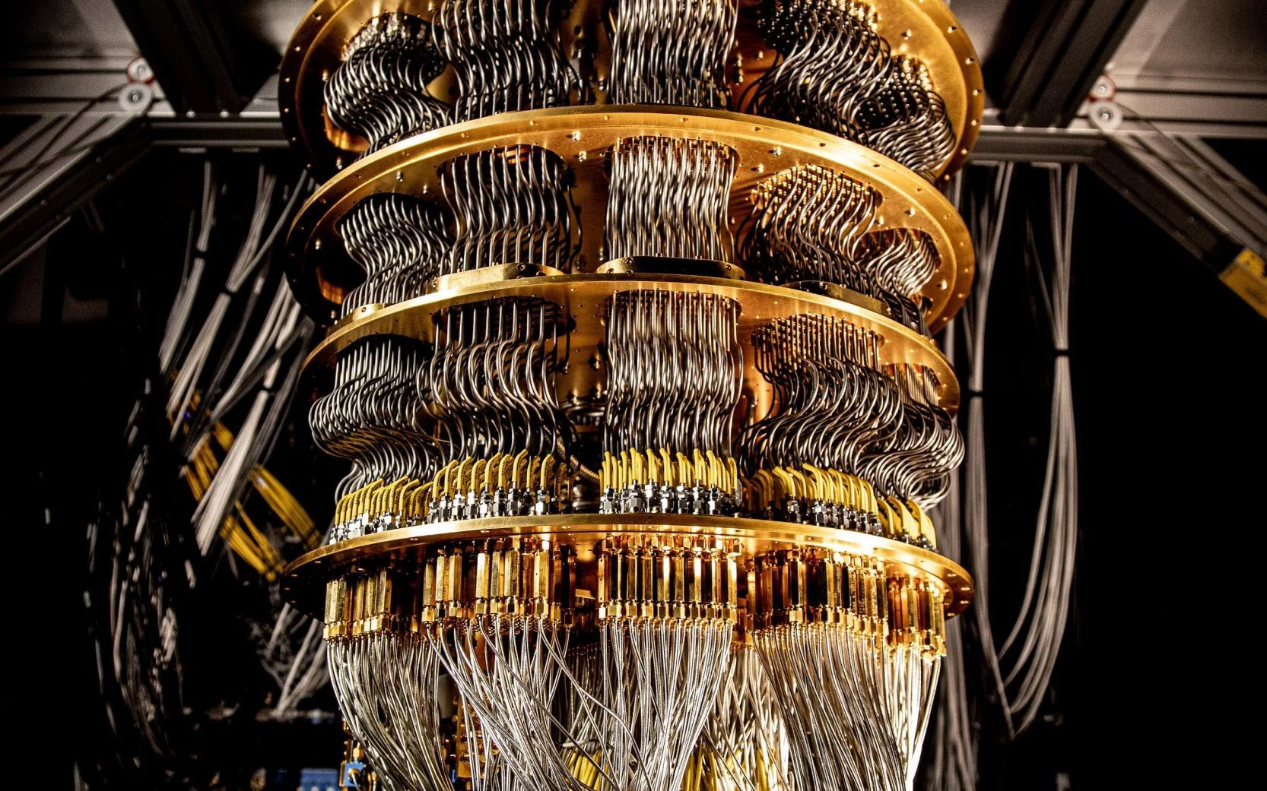
Quantum Computing
Quantum computing is a type of computing that leverages the principles of quantum mechanics to process information in ways that classical computers cannot
“It can help us solve physics problems where quantum machines and the interrelation of materials or properties are important,” Mark Potter, SVP and CTO of Hewlett Packard Enterprise
But not only, quantum computing can be applied in many fields:
Materials science, pharmaceutical research, subatomic physics, and logistics
Cryptography
Artificial Intelligence

Slide 3
Limits
Qubit Stability (Decoherence): Qubits are extremely sensitive to their environment and can lose their quantum state through a process called decoherence. This leads to errors in calculations. Maintaining qubit stability over a sufficient duration is one of the biggest challenges in quantum computing.
Scalability: Building large-scale quantum computers with a sufficient number of qubits for practical applications is a major hurdle. Currently, quantum computers have limited numbers of qubits, and scaling up while maintaining coherence and low error rates is a complex engineering challenge.
Hardware Limitations: Developing and maintaining the physical hardware for quantum computers, such as superconducting circuits or ion traps, is technologically challenging and expensive. These systems often require extremely low temperatures and precise control mechanisms.

Slide 4
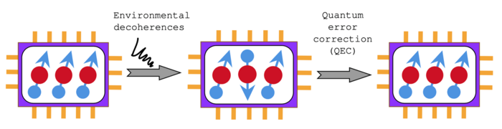
Quantum Error Correction…
ENCODING INFORMATION IN A REDUNDANT WAY
DETECT ERRORS
CORRECT ERRORS

Slide 5
…BUT
There are a number of complications for a straightforward application of classical error correcting codes to the quantum world:
NO-CLONING THEOREM: contrary to classical codes, where redundant bits can be added to the sequences in an arbitraru manner, we can’t clone qubits
A NEW TYPE OF ERROR: quantum error correcting codes must be designed to tackle also phase-flip errors, which are not present in classical systems
STATE COLLAPSE: in classical systems, data sequences can be read without compromising the encoded information. In quantum systems, however, any measurement performed as part of the error correction must be chosen so as not to cause the state to collpase and erase the encoded information

Slide 6
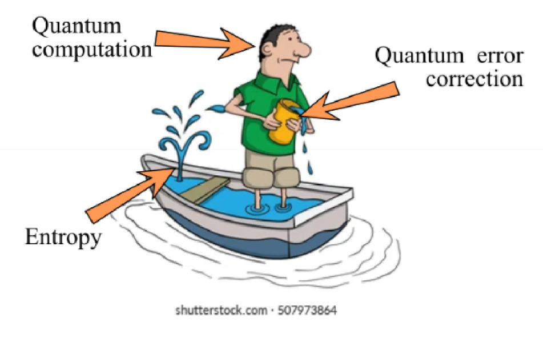
Fault tolerance
Errors are generated and start to accumulate very quickly
The only way to protect quantum information is constantly correct the newly occurring errors and be fast enough so that not too many errors accumulate, which would end up creating uncorrectable logical errors

Slide 7
Surface codes
Topological Protection: Surface codes use the topology of a 2D grid of qubits to detect and correct errors. The logical qubits are encoded in the global properties of the surface, making the system robust against local errors. Stabilizer Measurements: Errors are detected using stabilizer measurements, which involve measuring specific combinations of qubits without collapsing their quantum state. This process identifies error syndromes, which indicate the presence and location of errors. Scalability: Surface codes are designed to be scalable, as they can be implemented on large 2D grids of physical qubits. The overhead for error correction grows slowly with the size of the code, making it feasible to protect large-scale quantum computations.

Slide 8
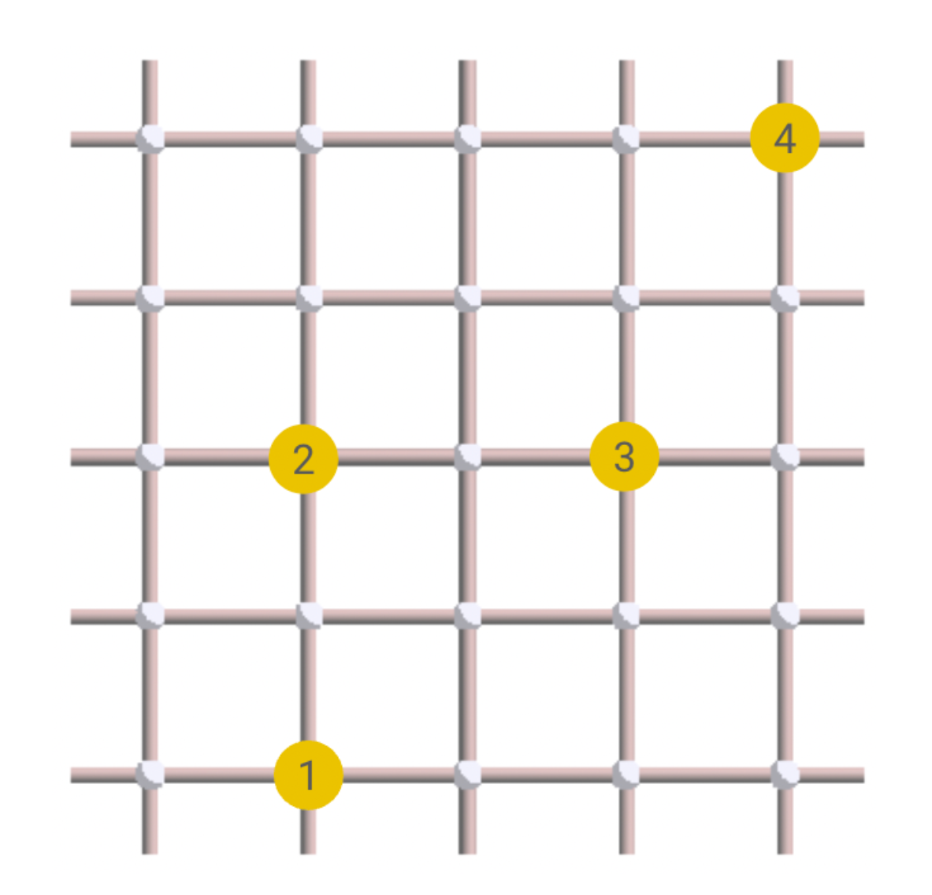
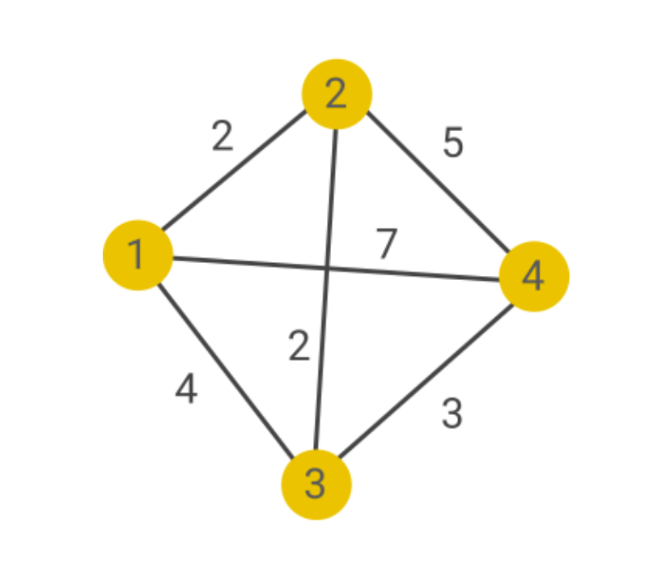
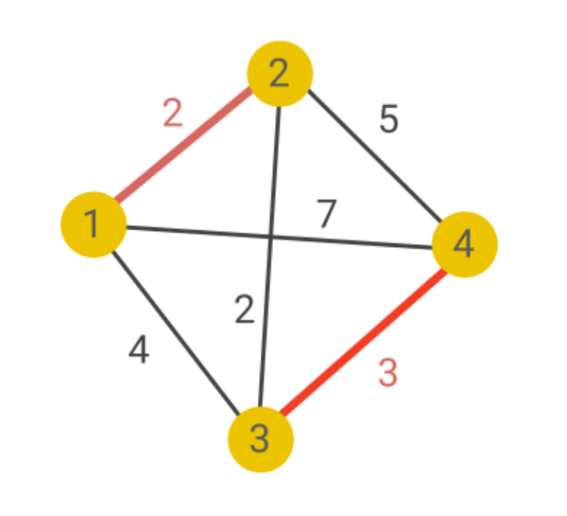
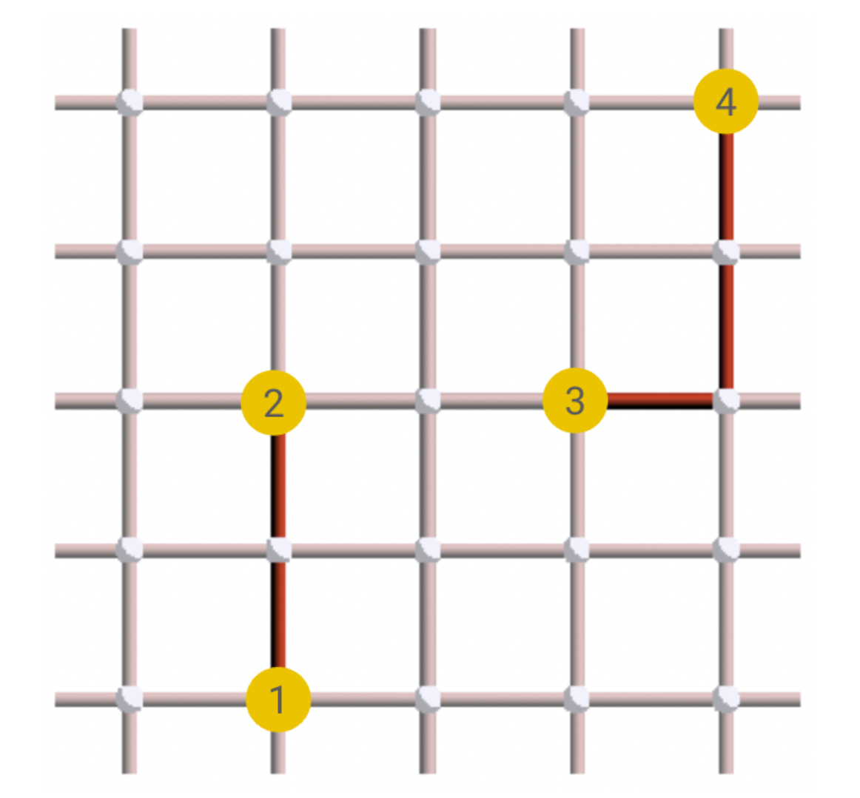
ERROR DETECTION MODEL & Minimum-Weight Perfect Matching

Slide 9
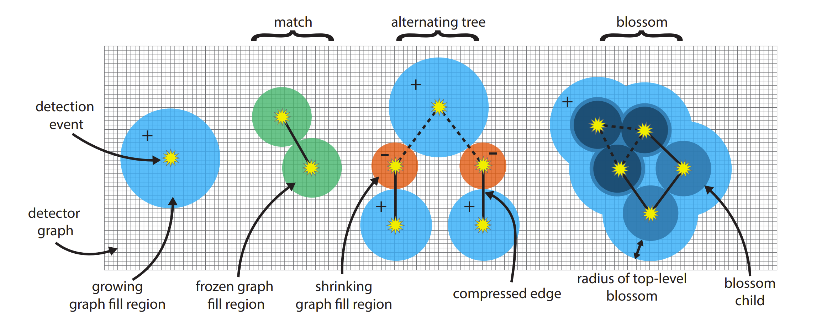
Sparse Blossom Algorithm

Slide 10
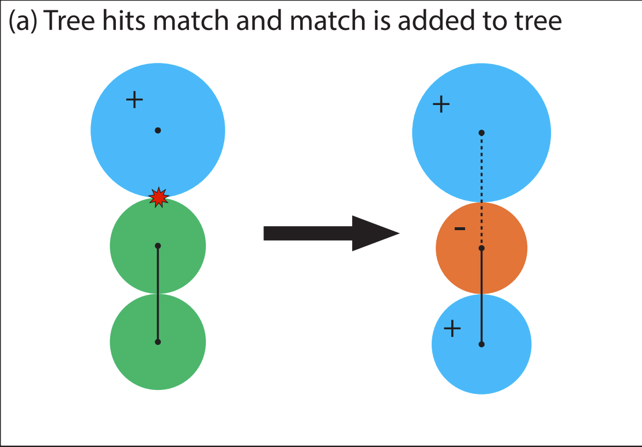
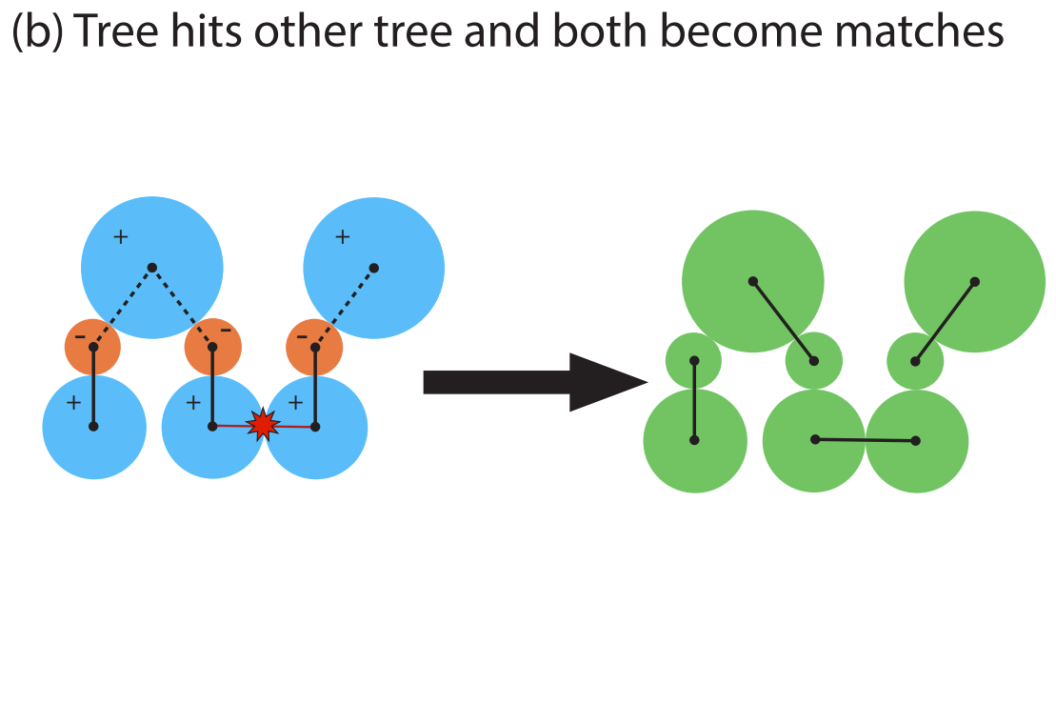
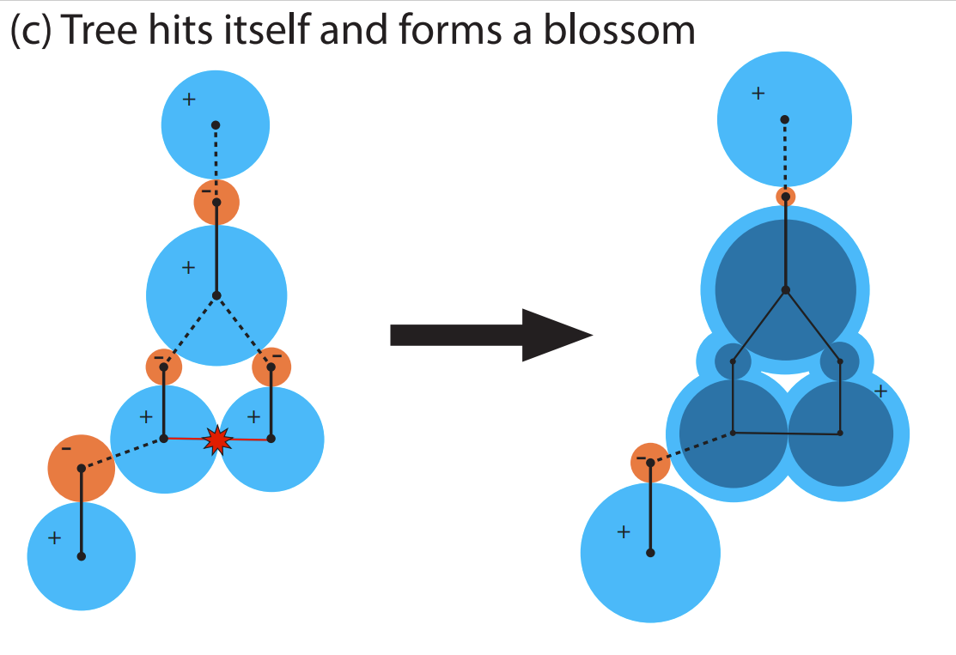
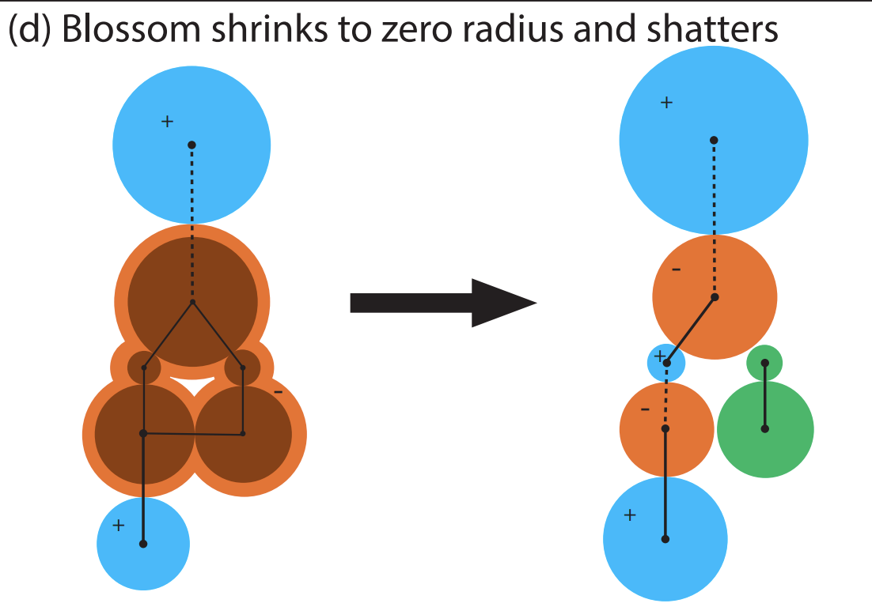
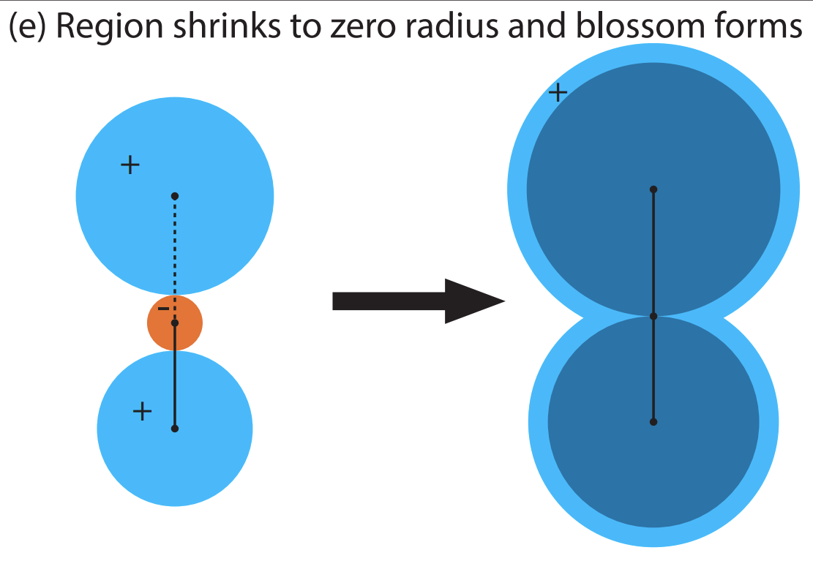
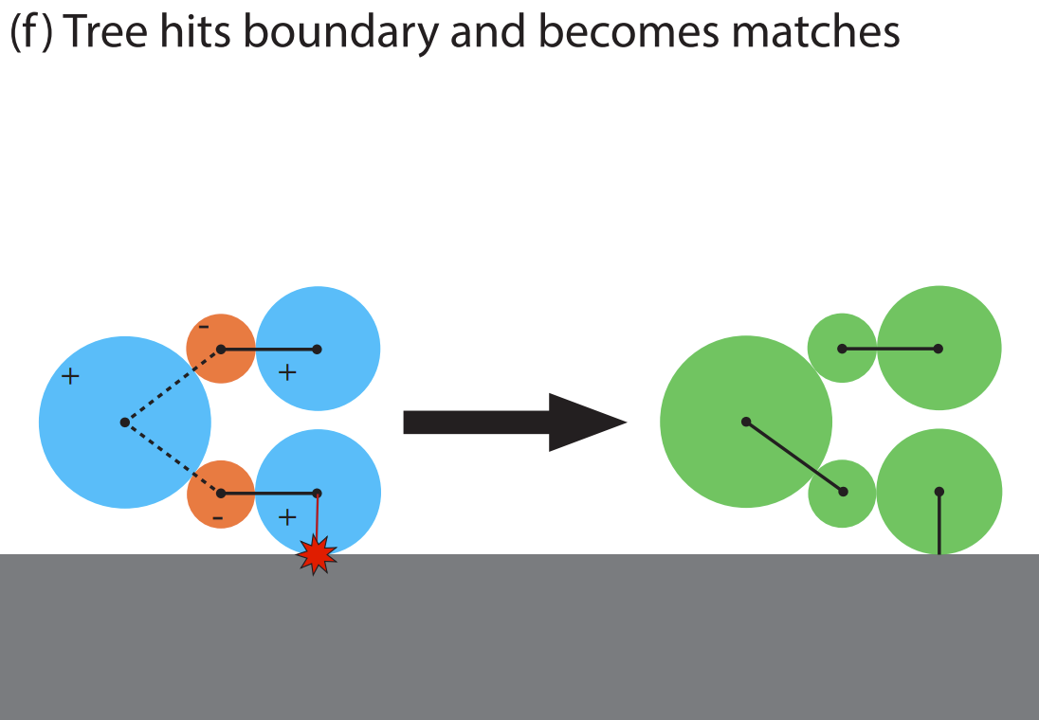

Slide 11
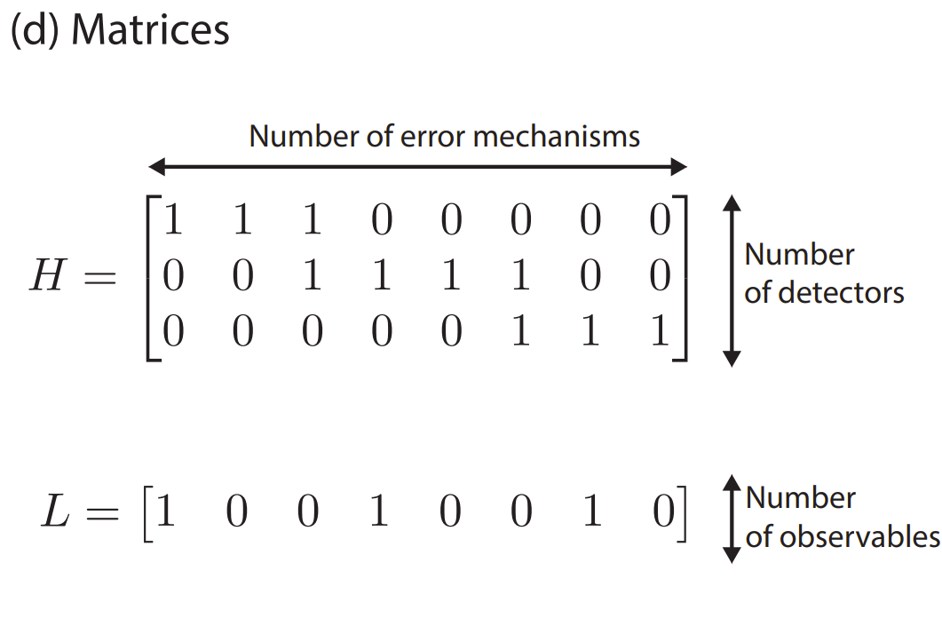

And then what?
Once we found the most probable errors , computing the corrections c is straightforward
$$c=H ∙e$$

Slide 12
Sba’s components

Slide 13
MAIN Challenges WE ENCOUNTERED
Proposed Solutions:
USE OF A HLS LEVEL CACHE IN ORDER TO EXPLOIT DATA LOCALITY
REWRITING RECURSIVE FUNCTIONS IN A NON-RECURSIVE FASHION
CHOOSING REASONABLE BOUNDS TO USE STATICALLY ALLOCATED MEMORY AND BALANCE BETWEEN SCALABILITY AND RESOURCE USAGE
Strong data dependency
Recursive functions
Sotware optimizations realized through dynamic memory allocation

Slide 14
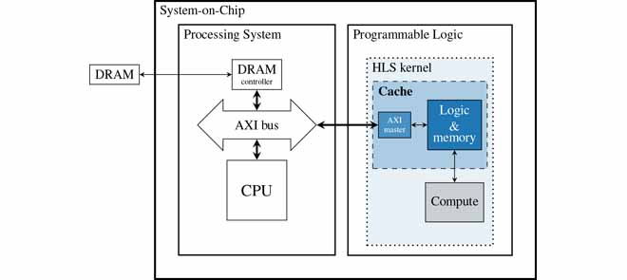
Cache

Slide 15
Experimental Results
Manual test on a small grapH
Modifying pymatching source code
Generating a log of the events happening in the algorithm
Checking correctness of results wrt our version
Speedup evaluation

Slide 16
Future Work and Conclusions
Completing the acceleration
Cache configuration space exploration
Rtl cache

